Slide 1
GreenDroid: A Mobile
Application Processor for a Future of Dark Silicon
Nathan Goulding, Jack Sampson, Ganesh Venkatesh,
Saturnino Garcia, Joe Auricchio, Jonathan Babb⁺,
Michael B. Taylor, and Steven Swanson
Department of Computer Science and Engineering,
University of California, San Diego
⁺ CSAIL, Massachusetts Institute of Technology
Hot Chips 22
Aug. 23, 2010
Notes:
In this talk I'm going to discuss three things:
The first centers around this dark silicon problem. For those of you who don't know, even today power limitations prevent us from using all of a chip's resources at full speed. Dark silicon refers to the increasing fraction of a chip's area which must remain mostly passive, or *dark*, so that it doesn't exceed the chip's power budget.
In this talk I'll show why this problem is happening, and exactly how bad it is… and it's bad.
2. The second thing I'm going to talk about is a way to take this dark silicon and use it to make processors more efficient. The basic idea is that we're going to use the dark silicon to build a large collection of specialized cores, each of which can save up to 11 times more energy for targeted code, compared to a general-purpose processor.
3. The last thing I'm going to talk about is how my colleagues and I are applying this technique to build a better mobile application processor, that is, a better processor for your Android or iPhone.

Slide 2
Where does dark silicon come from? (And how dark is it going to be?)
Utilization Wall:
With each successive process generation, the percentage of a chip that can actively switch drops exponentially due to power constraints.
Notes:
Where does this dark silicon come from? And how dark is it going to be?
In order to address these questions, I'll introduce a phenomenon that we call the utilization wall.
The utilization wall states that…
This means that each time we move to the next process generation, more and more of the chip becomes dark silicon.

Slide 3
We've Hit The Utilization Wall
Utilization Wall: With each successive process generation, the percentage of a chip that can actively switch drops exponentially due to power constraints.
Scaling theory
  Transistor and power budgets are no longer balanced
  Exponentially increasing problem!
Experimental results
  Replicated a small datapath
  More "dark silicon" than active
Observations in the wild
  Flat frequency curve
  "Turbo Mode"
  Increasing cache/processor ratio
Notes:
In fact, we've already hit the utilization wall, and I'm going to demonstrate this with three different sources of evidence:
Scaling theory
Experiments
Observations in the wild

Slide 4
We've Hit The Utilization Wall
Utilization Wall: With each successive process generation, the percentage of a chip that can actively switch drops exponentially due to power constraints.
Scaling theory
  Transistor and power budgets are no longer balanced
  Exponentially increasing problem!
Experimental results
  Replicated a small datapath
  More "dark silicon" than active
Observations in the wild
  Flat frequency curve
  "Turbo Mode"
  Increasing cache/processor ratio
Classical scaling
  Device count S²
  Device frequency S
  Device power (cap) 1/S
  Device power (V_{dd}) 1/S²
  Utilization 1
Leakage-limited scaling
  Device count S²
  Device frequency S
  Device power (cap) 1/S
  Device power (V_{dd}) ~1
  Utilization 1/S²
Notes:
Under the classical scaling model, for each process shrink by factor S, there is an S-squared increase in the number of transistors, and a factor of S increase in device frequency.
At the same time, power goes down by a factor of S because of lower gate capacitance, and S-squared because of lower supply voltage.
For a fix power budget, the total utilization of a chip is the product of these terms, and under the classical scaling model it remains constant.
This was great, because it meant each process shrink afforded us more transistors without increasing total chip power.
Unfortunately transistor threshold voltage is no longer scaling because of exponential rising leakage currents.
As a result, we've entered a leakage-limited regime, and we no longer see power reduction benefits due to voltage scaling.
This means that chip utilization goes down by a factor of S-squared with every process generation.
P = (alpha)*cap*freq*Vdd^2

Slide 5
We've Hit The Utilization Wall
Utilization Wall: With each successive process generation, the percentage of a chip that can actively switch drops exponentially due to power constraints.
Scaling theory
  Transistor and power budgets are no longer balanced
  Exponentially increasing problem!
Experimental results
  Replicated a small datapath
  More "dark silicon" than active
Observations in the wild
  Flat frequency curve
  "Turbo Mode"
  Increasing cache/processor ratio
2x
2x
2x
Notes:
As shown in this graph, this is an exponentially worsening problem:
The utilization goes down by half each time we move from 90 nm, to 65, to 45 and beyond.

Slide 6
We've Hit The Utilization Wall
Utilization Wall: With each successive process generation, the percentage of a chip that can actively switch drops exponentially due to power constraints.
Scaling theory
  Transistor and power budgets are no longer balanced
  Exponentially increasing problem!
Experimental results
  Replicated a small datapath
  More "dark silicon" than active
Observations in the wild
  Flat frequency curve
  "Turbo Mode"
  Increasing cache/processor ratio
2.8x
2x
Notes:
We have verified this in our lab using a real Synopsys CAD flow.
We replicated a small datapath across a 40-square-mm chip in a 90 nm TSMC process.
We found that only 5% could remain active within a 3-watt power budget.
Moving to 45 nm drops the utilization to just 1.8%, and using ITRS projections, we predict another factor of 2 decrease when moving to 32 nm.

Slide 7
We've Hit The Utilization Wall
Utilization Wall: With each successive process generation, the percentage of a chip that can actively switch drops exponentially due to power constraints.
Scaling theory
  Transistor and power budgets are no longer balanced
  Exponentially increasing problem!
Experimental results
  Replicated a small datapath
  More "dark silicon" than active
Observations in the wild
  Flat frequency curve
  "Turbo Mode"
  Increasing cache/processor ratio
2.8x
2x
Notes:
Finally, we've also seen evidence of the util. wall in the wild.
Processor frequencies are no longer scaling like they used to, and the frequency curve has tipped over since about 2005.
As another example, Intel's Nehalem architecture has "Turbo Mode", in which some of the cores run faster when the remaining cores are switched off.
Finally, we see an increasing cache/processor ratio in new chips, as more die area is dedicated to lower-activity cache instead of high-activity compute logic.
Our observations show us the utilization wall is already here, and scaling theory says things are just going to get worse.

Slide 8
We've Hit The Utilization Wall
Utilization Wall: With each successive process generation, the percentage of a chip that can actively switch drops exponentially due to power constraints.
Scaling theory
  Transistor and power budgets are no longer balanced
  Exponentially increasing problem!
Experimental results
  Replicated a small datapath
  More "dark silicon" than active
Observations in the wild
  Flat frequency curve
  "Turbo Mode"
  Increasing cache/processor ratio
The utilization wall will change the way
everyone builds processors.
2.8x
2x
Notes:
This is a huge problem!
The utilization wall is here, and it will change the way everyone builds processors.
The utilization wall means that our chips will soon be full of dark silicon.

Slide 9
Utilization Wall:
Dark Implications for Multicore
Spectrum of tradeoffs
between # of cores and
frequency
Example:
65 nm → 32 nm (S = 2)
.…
2x4 cores @ 1.8 GHz
(8 cores dark, 8 dim)
(Industry’s Choice)
4 cores @ 1.8 GHz
.…
.…
4 cores @ 2x1.8 GHz
(12 cores dark)
9
65 nm
32 nm
Notes:
Skipped for time

Slide 10
What do we do with dark silicon?
Goal: Leverage dark silicon to scale the utilization wall
Insights:
  Power is now more expensive than area
  Specialized logic can improve energy efficiency (10–1000x)
Our approach:
  Fill dark silicon with specialized cores to save energy on
  common applications
  Provide focused reconfigurability to handle evolving workloads
10
Notes:
So what do we do with all this dark silicon?
Well a couple of insights stand out:
1. power is now more expensive than area, so trading area for reduced power is a win overall
2. specialized logic can provide orders of magnitude improvement in energy efficiency
Our approach is based on these insights.
We fill dark silicon with specialized cores to save energy on common apps.
As I'll show later on, the cores include patching mechanisms to remain useful even as the software changes.

Slide 11
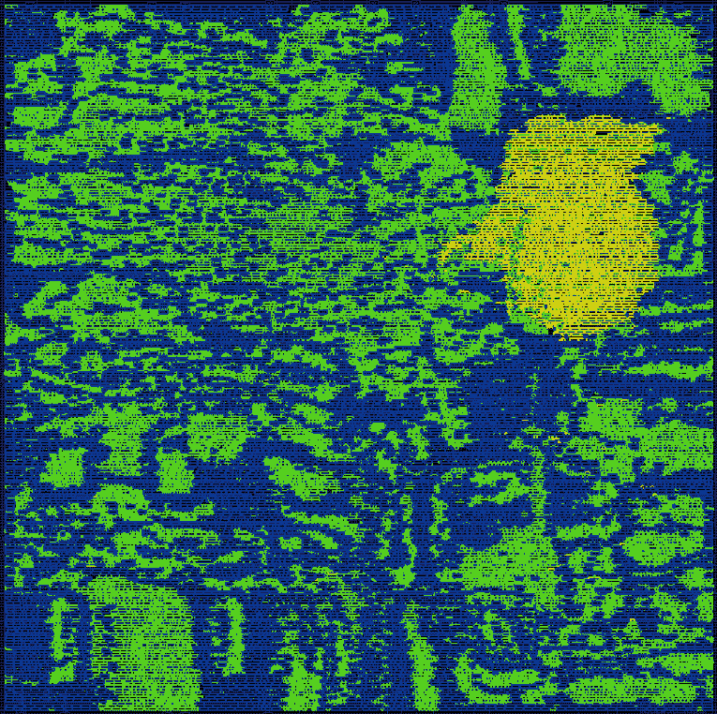
Conservation Cores
"Conservation Cores: Reducing the Energy of Mature Computations," Venkatesh et al.,
ASPLOS '10
Specialized circuits for
reducing energy
  Automatically generated from hot regions of program source code
  Patching support future-proofs the hardware
Fully-automated toolchain
  Drop-in replacements for code
  Hot code implemented by c-cores, cold code runs on host CPU
  HW generation/SW integration
Energy-efficient
  Up to 18x for targeted hot code
Hot code
D-cache
C-core
Host
CPU
(general-purpose
processor)
I-cache
Cold code
Notes:
Conservation cores, or c-cores, are specialized circuits for reducing energy in target applications.
As shown in this diagram, c-cores sit next to a general-purpose "host" processor, and share the same data cache and memory hierarchy.
*Hot*, or frequently executed code runs on one or more c-cores, at a great reduction in energy.
*Cold* code, such as start-up and tear-down, or infrequently executed code, runs on the general-purpose processor.
Execution transfers back and forth between the two.
We generate c-cores from app. source code using a fully-automated toolchain.
The toolchain generates synthesizable Verilog, and also integrates c-cores with the software by inserting function stubs that call the c-cores during execution.
C-cores are extremely energy-efficient. They can provide up to 18x better energy savings than a general-purpose MIPS processor.
Conservation cores provide an architectural way to trade a cheap resource for an expensive one: in this case, area for power.

Slide 12
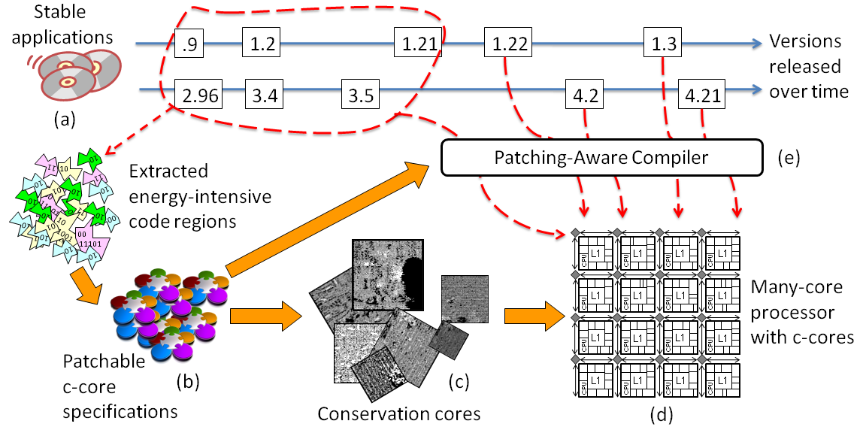
The C-core Life Cycle
Notes:
Now let's look at the life cycle of a c-core.
We start with a target workload, and send the applications to our toolchain.
The toolchain profiles the apps and extracts the energy-intensive code regions for conversion into c-cores.
We generate the c-core hardware, and use it to fill the dark silicon of a many-core processor.
Now over time the software may change, as new versions are released.
Our compiler can analyze the differences between versions to generate a patch, that allows an old c-core to run the latest version of the software. This allows the c-cores to remain useful even in the face of SW changes.

Slide 13
Outline
Utilization wall and dark silicon
GreenDroid
Conservation cores
GreenDroid energy savings
Conclusions
Notes:
I've introduced conservation cores as one method to leverage dark silicon in order to scale the utilization wall.
In the remainder of my talk I'll present GreenDroid: a new mobile app. processor we are developing at UCSD.
I'll show you the GreenDroid architecture and our work in designing a prototype chip.
Then, I'll describe conservation cores in more detail, and show how they can achieve up to 18x energy-improvement for even irregular, integer programs
Finally, I'll discuss GreenDroid's projected energy savings, and wrap up with some brief conclusions

Slide 14
Emerging Trends
The utilization wall is exponentially worsening the
dark silicon problem.
Specialized architectures are receiving more and more attention because of energy efficiency.
Mobile application processors are becoming a dominant
computing platform for end users.
1Q Shipments,
Thousands
Android
iPhone
Dell
Historical Data: Gartner
Notes:
To better understand GreenDroid, let's take a look at some emerging trends.
The util. wall is exp. worsening the dark Si problem.
As a result, specialized arch's are receiving more and more attention because of energy efficiency.
At the same time, mobile app. processors are becoming the dominant computing platform for many end users.
This graph plots Android and iPhone sales vs. Dell computers over the last three years.
It also shows projections for the next year, and as you can see, handheld devices are taking off at an exponential rate.

Slide 15
Mobile Application Processors Face the Utilization Wall
The evolution of mobile application processors mirrors
that of microprocessors
Application processors
face the utilization wall
  Growing performance
  demands
  Extreme power
  constraints
Cortex-A9
MPCore
Core Duo
multicore
686
Cortex-A9
out-of-order
586
Cortex-A8
superscalar
486
StrongARM
pipelining
Notes:
Another interesting trend is that the evolution of MAPs is mirroring that of u-procs.
This graph shows a timeline of architectural features added to Intel and ARM processors.
Looking at the blue line, we start with the pipelined 486 and move to superscalar, out-of-order, and now multicore designs.
The red line shows how application processors are following a similar progression.
Unfortunately, MAPs also face the utilization wall, because of their growing performance demands and extreme power constraints in the embedded design space.
➔ So what do people use MAPs for? Let's take a closer look at one example, which is Android.
notes: StrongARM is SA-110

Slide 16

Android™
Google’s OS + app. environment for mobile devices
Java applications run on the
Dalvik virtual machine
Apps share a set of libraries
(libc, OpenGL, SQLite, etc.)
Applications
Libraries
Dalvik
Linux Kernel
Hardware
Notes:
Android is Google's operations system and application environment for mobile devices.
This diagram shows the Android software stack running on typical hardware.
Android apps are written in Java, and compiled to run on the Dalvik virtual machine, shown here.
The apps share a set of libraries, such as libc, OpenGL, SQLite, and many others.
With this software model, Android is well-suited for conservation cores.

Slide 17
Applying C-cores to
Android
Android is well-suited for c-cores
  Core set of commonly used applications
  Libraries are hot code
  Dalvik virtual machine is hot code
  Libraries, Dalvik, and kernel &
  application hotspots → c-cores
  Relatively short hardware
  replacement cycle
Applications
Libraries
Dalvik
Linux Kernel
C-cores
Hardware
Notes:
This is because Android smartphones run a core set of common applications, such as a web browser, email client, and various media players.
These apps run on the shared libraries and Dalvik, making this part of the SW stack *hot code*.
We can also find hotspots in specific applications and the Linux kernel,
and we can convert all these hotspots into *c-cores*.
Another reason Android is a good fit for c-cores is that there is a short replacement cycle for smartphones.
Most consumers replace their smartphones every 2-3 years.
We can add new c-cores to future processors as new applications appear and become popular.
The c-cores interface allows us to remove c-cores without impacting code compatibility: if a c-core no longer exists, the software can still fall back to the GP proc.

Slide 18
Android Workload Profile
Profiled common Android apps to find the hot spots, including:
  Google: Browser, Gallery, Mail, Maps, Music, Video
  Pandora
  Photoshop Mobile
  Robo Defense game
Broad-based c-cores
  72% code sharing
Targeted c-cores
  95% coverage with just
  43,000 static instructions
  (approx. 7 mm²)
Targeted
Broad-based
Notes:
-To quantify these benefits, we created a workload of common Android applications.
-We profiled this workload to determine how much code we would need to convert into c-cores
in order to achieve high execution coverage.
-This graph shows the percentage of dynamic execution coverage versus the number of static instructions converted into c-cores.
-We divide the c-cores into two categories: broad-based, and targeted.
-Broad-based c-cores are c-cores that are shared by two or more applications.
We find that of the hottest 40-thousand static instrs, 72% of the code is shared by more than one application.
We can convert this code into broad-based c-cores, for use by multiple applications.
-We can also build c-cores that are *targeted* for one specific app.
Adding targeted c-cores to the mix, we can achieve 95% execution coverage with just 43,000 static instrs converted into c-cores.
This is the equivalent of about 7-square-mms of silicon in 45 nm.

Slide 19
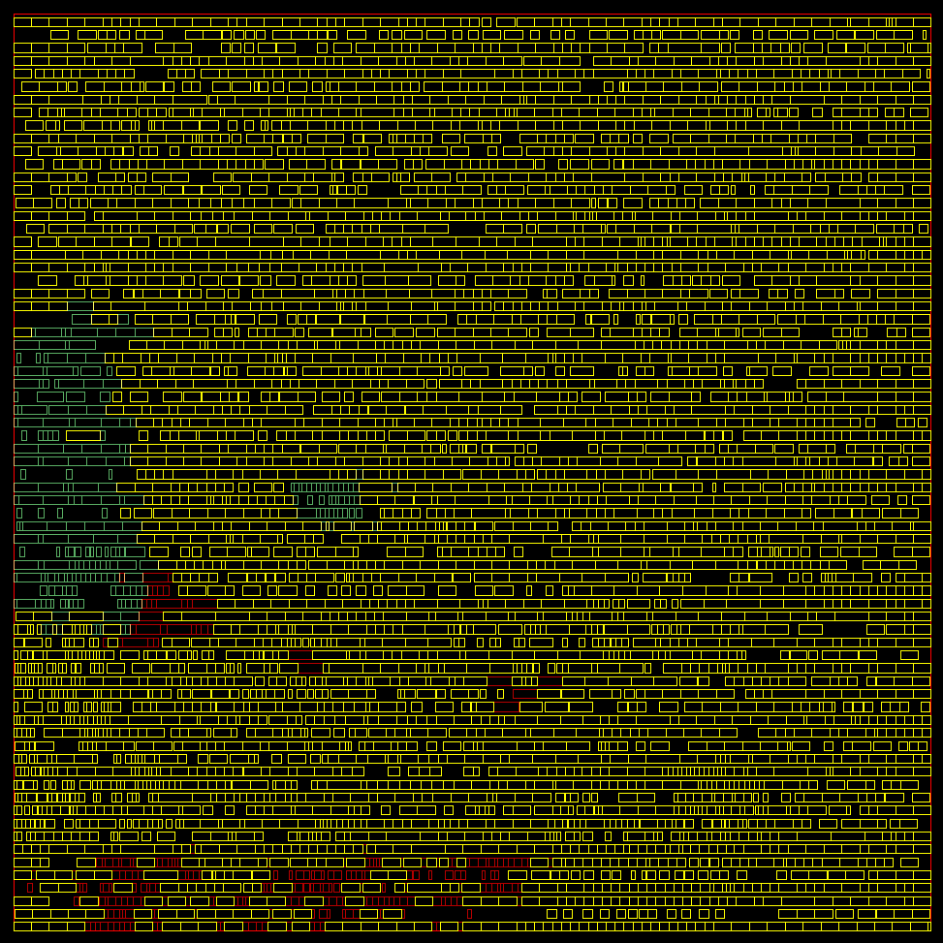
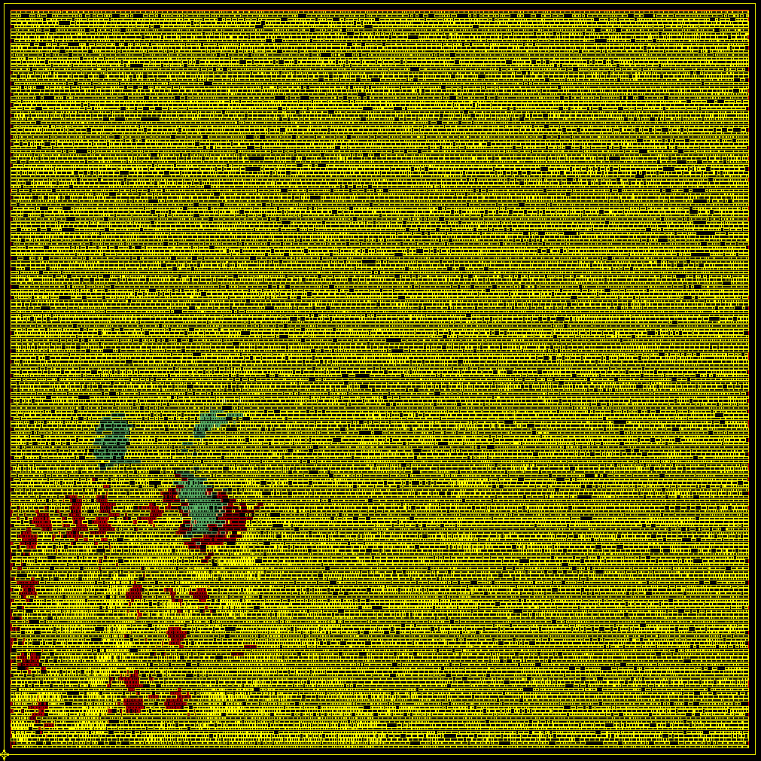
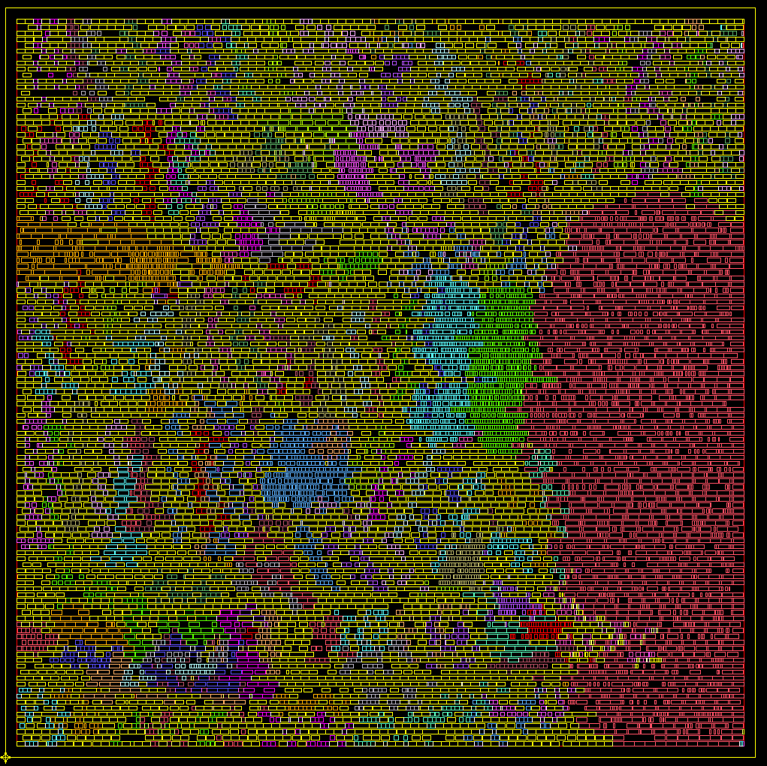

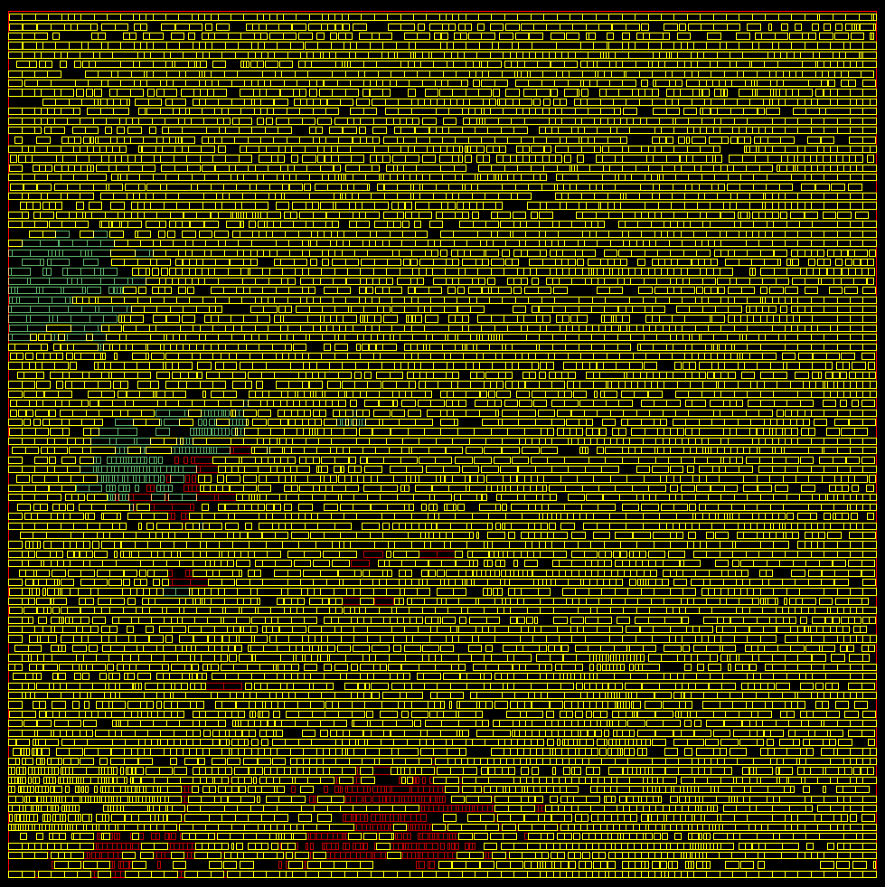
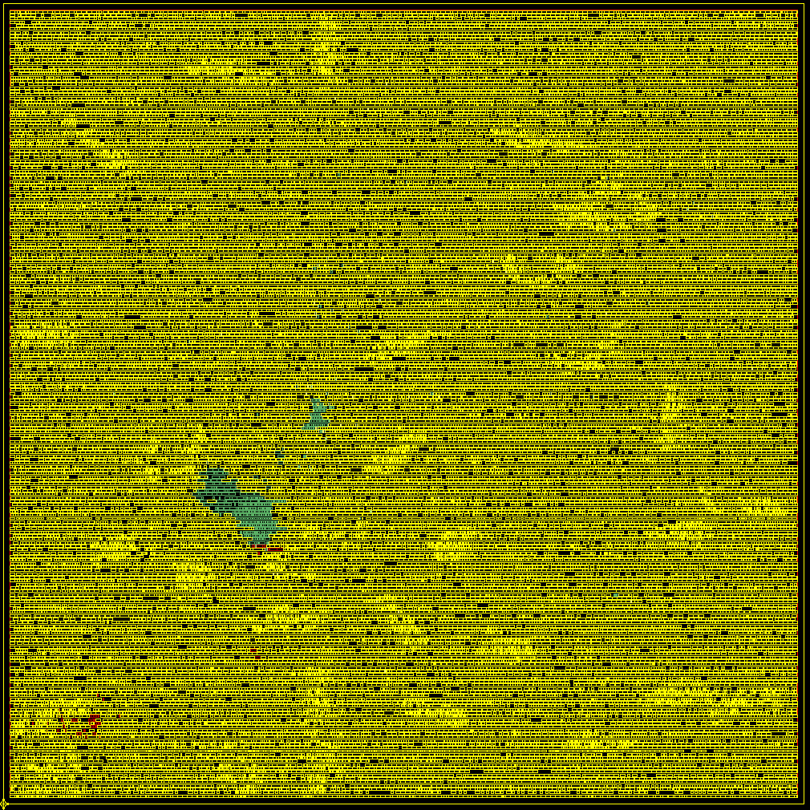
GreenDroid: Applying Massive Specialization to Mobile Application Processors
Android
workload
L1
L1
L1
L1
CPU
CPU
CPU
CPU
L1
L1
L1
L1
CPU
CPU
CPU
CPU
Automatic
c-core
generator
L1
L1
L1
L1
CPU
CPU
CPU
CPU
L1
L1
L1
L1
CPU
CPU
CPU
CPU
Low-power
tiled multicore
lattice
Conservation cores
(c-cores)
Notes:
- In order to create GreenDroid, we start by taking a number of Android workloads and running the apps. through our automatic c-core generator.
- We use these c-cores to populate a low-power tiled multicore lattice.
➔ Let's take a closer look at the GreenDroid architecture.

Slide 20
GreenDroid Tiled Architecture
Tiled lattice of 16 cores
Each tile contains
  6-10 Android c-cores
  (~125 total)
  32 KB D-cache
  (shared with CPU)
  MIPS processor
    32 bit, in-order,
    7-stage pipeline
    16 KB I-cache
    Single-precision FPU
  On-chip network router
L1
L1
L1
L1
CPU
CPU
CPU
CPU
L1
L1
L1
L1
CPU
CPU
CPU
CPU
L1
L1
L1
L1
CPU
CPU
CPU
CPU
L1
L1
L1
L1
CPU
CPU
CPU
CPU
Notes:
- GreenDroid is a tiled lattice consisting of 16 cores.
Each tile contains…
Next, let's zoom in and look at an individual tile

Slide 21
GreenDroid Tile Floorplan
1.0 mm² per tile
50% C-cores
25% D-cache
25% MIPS core,
I-cache, and
on-chip network
OCN
C
C
C
C
C
I $
C
1 mm
D $
C
CPU
C
C
C
1 mm
Notes:
This floorplan shows how each tile is a square, one millimeter to a side.
Half of the area is dedicated to c-cores.
In the center is the shared data cache,
and the remainder of the area is allocated to the MIPS core and network router.

Slide 22
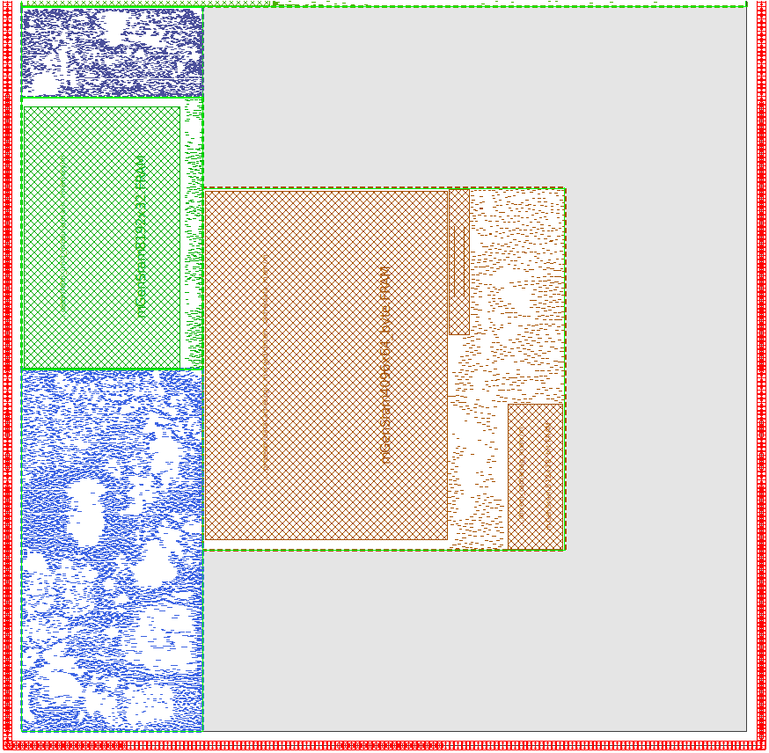
GreenDroid Tile Skeleton
OCN
C-cores
45 nm process
1.5 GHz
~30k instances
Blank space is filled with
a collection of c-cores
Each tile contains
different c-cores
I $
D $
CPU
Notes:
We've implemented a skeleton for GreenDroid tiles in a 45 nm process targeting 1.5 GHz.
On the right you can see a large blank space, that will be filled with a collection of c-cores.
Each tile can contain a different collection of c-cores.

Slide 23
Outline
Utilization wall and dark silicon
GreenDroid
Conservation cores
GreenDroid energy savings
Conclusions
Notes:
Now that we've seen what a GreenDroid processor looks like at a high level, let's take a closer look at the heart of our solution, conservation cores.
➔ We'll start by seeing how c-cores are built.

Slide 24
Constructing a C-core
C-cores start with source code
  Can be irregular, integer programs
  Parallelism-agnostic
Supports almost all of C:
  Complex control flow
  e.g., goto, switch, function calls
  Arbitrary memory structures
  e.g., pointers, structs, stack, heap
  Arbitrary operators
  e.g., floating point, divide
  Memory coherent with host CPU
sumArray(int *a, int n)
{
int i = 0;
int sum = 0;
for (i = 0; i < n; i++) {
sum += a[i];
}
return sum;
}
Notes:
C-cores start with app source code.
But unlike most accelerators, the apps can be irregular, integer programs,
because c-cores are parallelism-agnostic.
Our toolchain can support almost all of C, including …
Now let's go through the conversion process with a simple example. The code shown on the right sums the elements of an array. Let's turn this function into a c-core.

Slide 25
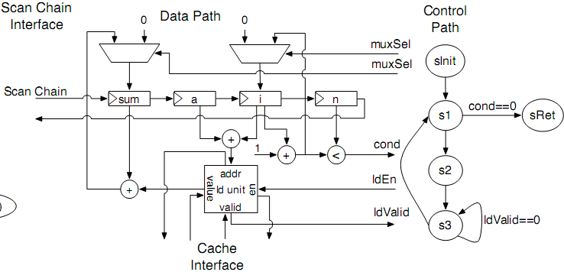

Constructing a C-core
Compilation
  C-core selection
  SSA, infinite register,
  3-address code
  Direct mapping from
  CFG and DFG
  Scan chain insertion
Verilog → Place & Route
  45 nm process
  Synopsys CAD flow
    Synthesis
    Placement
    Clock tree generation
    Routing
0.01 mm², 1.4 GHz
Notes:
Starting with a particular application, our toolchain profiles the execution behavior to determine the app. hotspots.
We convert these hotspots into an intermediate representation, which we use to generate synthesizeable Verilog.
The top diagram shows the hardware for our sum-array example. There is a control unit,
and datapath,
which directly map to the control-flow and dataflow graphs of the original program.
At this stage our toolchain also inserts architecturally-visible scan chains that allow us to access a c-cores internal state. As I'll show later on, we can use these scan chains to support software exceptions, allowing old c-cores to run new versions of the software.
Next, the toolchain processes the synthesizeable Verilog in a 45-nm Synopsys CAD flow,
which takes the c-cores through P&R.
Our sum-array loop synthesizes to just 1/hundredth of a square-mm, and runs at 1.4 GHz.
So that's how we build c-cores. Now let's see how they perform.

Slide 26
C-cores Experimental Data
We automatically built 21 c-cores for 9 "hard" applications
  45 nm TSMC
  Vary in size from
  0.10 to 0.25 mm²
  Frequencies from
  1.0 to 1.4 GHz
Application | # C-cores | Area (mm²) | Frequency (MHz)
bzip2 | 1 | 0.18 | 1235
cjpeg | 3 | 0.18 | 1451
djpeg | 3 | 0.21 | 1460
mcf | 3 | 0.17 | 1407
radix | 1 | 0.10 | 1364
sat solver | 2 | 0.20 | 1275
twolf | 6 | 0.25 | 1426
viterbi | 1 | 0.12 | 1264
vpr | 1 | 0.24 | 1074
Notes:
We've used our toolchain to automatically build 21 c-cores for 9 irregular, integer applications, including several from SPEC INT 2000 and 2006.
We synthesized these c-cores using a 45 nm TSMC process.
They vary in size from point-1 to point-2-5 square mm, and run at frequencies up to 1.4 GHz.
notes: *Individual* c-cores vary in size (0.02 to 0.24 mm^2) and frequency (1.0 to 1.8 GHz)

Slide 27
C-core Energy Efficiency:
Non-cache Operations
Up to 18x more energy-efficient (13.7x on average),
compared to running on the MIPS processor
Notes:
This graph shows the energy savings for non-memory operations compared to running on the MIPS processor.
The c-cores achieve up to 18x better energy efficiency than the MIPS processor, and more than 13x on average.
➔ Now where do these energy savings come from?
(notes: performance is comparable or better)

Slide 28
Where do the energy savings come from?
MIPS baseline
91 pJ/instr.
C-cores
8 pJ/instr.
Notes:
The pie chart on the left shows the breakdown of average energy per instruction for our baseline in-order MIPS processor.
Over half the energy is overhead, in the instruction cache, fetch unit, and global register file.
C-cores save energy here because there are no instructions, and registers are distributed throughout the datapath and only instantiated as necessary.
Another source of overhead is the general-purpose compute pipeline.
C-cores can reduce this energy by using custom functional units and bit-level optimizations.
➔ Highly-specialized circuits are great for saving energy, but what if the software changes?
notes:
Energy savings come from
No I-cache
No instruction fetch or decode
Custom datapath
Distributed registers (no register file)
Bit-level optimizations

Slide 29
Supporting Software Changes
Software may change – HW must remain usable
  C-cores unaffected by changes to cold regions
Can support any changes, through patching
  Arbitrary insertion of code – software exception mechanism
  Changes to program constants – configurable registers
  Changes to operators – configurable functional units
Software exception mechanism
  Scan in values from c-core
  Execute in processor
  Scan out values back to c-core to resume execution
Notes:
One downside of hard-wired solutions such as ASICs is that if the software changes at all (e.g., if a bug is discovered, or a protocol changes), the hardware becomes useless.
C-cores, however, can handle changes to the code in two ways.
First, c-cores are unaffected by changes to the cold regions of software, since these run on the GP proc.
Second, c-cores can handle arbitrary changes to the hot code through three *patching* mechanisms.
They can support arbitrary changes through a software exception mechanism, which I'll talk about shortly.
We can also optimize two special cases:
We can convert program constants into configurable registers,
and we can replace fixed operators with slightly generalized functional units (for example, replacing a fixed adder with an add/subtract unit).
Now I mentioned we can handle arbitrary changes through a software exception mechanism.
During c-core execution, we can replace basic blocks in hardware with arbitrary code in software. We do this by pausing a c-core and using the scan chains to scan in any necessary state.
The GPP runs the exception handler, and when done scans out any needed values back to the c-core.
The c-core then resumes executing.
➔ These patching mechanisms greatly extend the useful lifetime of c-cores.
notes: for more info, see our ASPLOS paper

Slide 30
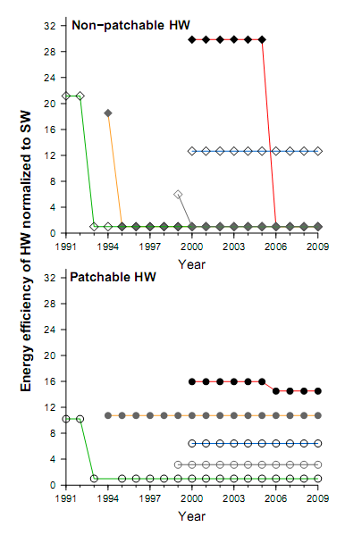
Patchability Payoff: Longevity
Graceful degradation
  Lower initial efficiency
  Much longer useful lifetime
Increased viability
  With patching, utility
  lasts ~10 years for
  4 out of 5 applications
  Decreases risks of specialization
Notes:
Patching mechanisms greatly extend the useful lifetime of our c-cores.
These graphs show c-core energy-efficiency normalized to a MIPS baseline as different versions of each application are released over time.
First, let's focus on the top graph. This is for non-patchable hardware—that is, hardware without the patching mechanisms I just described.
The top line represents "mcf" from SPEC 2000. The hardware achieves large energy savings compared to MIPS, until a new version of mcf is released in 2006. At this point energy savings drops to zero, because the application must run entirely in the GPP.
Similarly, 4 out of these 5 applications become useless when the new software is released.
The bottom graph demonstrates the benefits of *patchable* hardware. Again, the top line represents mcf, but this time when the new version is released, the c-core's efficiency savings just drop a little bit. 4 of the 5 applications remain useful even after the software changes.
Patching mechanisms decrease the risks sometimes associated with specialization, making c-cores more attractive.

Slide 31
Outline
Utilization wall and dark silicon
GreenDroid
Conservation cores
GreenDroid energy savings
Conclusions
Notes:
We've just seen how conservation cores can reduce the energy of even irregular, integer programs.
We've also seen how patching mechanisms greatly extend the useful lifetime of c-cores, even in the face of SW changes.
➔ Now let's return to GreenDroid and see how c-cores will save energy for Android applications.

Slide 32
GreenDroid:
Energy per Instruction
More area dedicated to c-cores yields higher execution coverage and lower energy per instruction (EPI)
7 mm² of c-cores provides:
  95% execution coverage
  8x energy savings over MIPS core
Notes:
In order to save the most energy, an application must run on c-cores instead of the GP proc. as much as possible.
As we saw earlier, we can achieve this by dedicating more silicon area to c-cores.
Effectively, the more area we have for c-cores, the lower the energy required for the workload, which goes back to what I was saying earlier about trading area for power.
Using our Android workload, we modeled the average energy per instruction of a GreenDroid processor with varying amounts of silicon dedicated to c-cores.
This graph shows the results.
Starting at the left, with no c-cores at all, the MIPS processor operates at 91 pJ/instr.
Adding c-cores quickly reduces this energy per instruction, and we find that
with just 7 square-mm's of c-cores, we can cover 95% of the workload execution, resulting in 8-times less energy use than the MIPS processor.
➔ Using this profile, we have also determined a list of candidate Android hotspots for conversion into c-cores.

Slide 33
What kinds of hotspots turn into GreenDroid c-cores?
C-core | Library | # Apps | Coverage (est., %) | Area (est., mm²) | Broad-based
dvmInterpretStd | libdvm | 8 | 10.8 | 0.414 | Y
scanObject | libdvm | 8 | 3.6 | 0.061 | Y
S32A_D565_Opaque_Dither | libskia | 8 | 2.8 | 0.014 | Y
src_aligned | libc | 8 | 2.3 | 0.005 | Y
S32_opaque_D32_filter_DXDY | libskia | 1 | 2.2 | 0.013 | N
less_than_32_left | libc | 7 | 1.7 | 0.013 | Y
cached_aligned32 | libc | 9 | 1.5 | 0.004 | Y
.plt | <many> | 8 | 1.4 | 0.043 | Y
memcpy | libc | 8 | 1.2 | 0.003 | Y
S32A_Opaque_BlitRow32 | libskia | 7 | 1.2 | 0.005 | Y
ClampX_ClampY_filter_affine | libskia | 4 | 1.1 | 0.015 | Y
DiagonalInterpMC | libomx | 1 | 1.1 | 0.054 | N
blitRect | libskia | 1 | 1.1 | 0.008 | N
calc_sbr_synfilterbank_LC | libomx | 1 | 1.1 | 0.034 | N
inflate | libz | 4 | 0.9 | 0.055 | Y
. . . | . . . | . . . | . . . | . . . | . . .
Notes:
This list includes some of the most-frequently executed code in our Android workload.
* The table is sorted by execution coverage.
* The top two functions are from the Dalvik virtual machine, at 14.4% coverage.
* There are a number of functions from the 2D graphics library "libskia", covering 8.4%.
* There are also some memory management functions from libc, covering almost 7%. (6.7)
* We can convert these functions—and many more—into c-cores, for great energy savings.
➔ Now we can compare GreenDroid to typical mobile app. processors.

Slide 34
GreenDroid: Projected Energy
Aggressive mobile application processor
(45 nm, 1.5 GHz)
GreenDroid c-cores
GreenDroid c-cores + cold code (est.)
GreenDroid c-cores use 11x less energy per instruction than an aggressive mobile application processor
Including cold code, GreenDroid will still save ~7.5x energy
91 pJ/instr.
8 pJ/instr.
12 pJ/instr.
Notes:
Our baseline system for comparison is an aggressive mobile application processor running at 1.5 GHz in 45 nm.
We conservatively estimate that it operates at 91 pJ/instr., including compute power and cache access.
We have measured c-core power using post-P&R gate-level simulations and Synopsys PrimeTime.
C-cores use the equivalent of just 8 pJ/instruction, which is 11-times better than the baseline processor.
Cold code, or code that has not been converted into c-cores, must fall back to the general-purpose processor. At our projected 95% execution coverage, this still results in an EPI of 12 pJ, which is about 7.5 times better than the baseline proc.
➔ Now I'll tell you about the current project status

Slide 35
Project Status
Completed
  Automatic generation of c-cores from source code to place & route
  Cycle- and energy-accurate simulation (post place & route)
  Tiled lattice, placed and routed
  FPGA emulation of c-cores and tiled lattice
Ongoing work
  Finish full system Android emulation for more accurate
  workload modeling
  Finalize c-core selection based on full system Android
  workload model
  Timing closure and tapeout
Notes:
So now I'll tell you about the current status in developing a prototype chip.
We have developed a toolchain for automatically generating c-cores from application source code and taking them through place & route.
We've also made a cycle- and energy-accurate simulator for the c-cores and tiled lattice.
In addition to this, we have FPGA emulation running for the c-cores and lattice.
Ongoing work includes finishing full system Android emulation, so that we can get more accurate models of the workload.
We will use these models to finalize our c-core selection, and then we can finish timing closure and tapeout.

Slide 36
GreenDroid Conclusions
The utilization wall forces us to change how we
build hardware
Conservation cores use dark silicon to attack
the utilization wall
GreenDroid will demonstrate the benefits of c-cores for mobile application processors
We are developing a 45 nm tiled prototype at UCSD
Notes:
Conclusions

Slide 37
GreenDroid: A Mobile
Application Processor for a Future of Dark Silicon
Nathan Goulding, Jack Sampson, Ganesh Venkatesh,
Saturnino Garcia, Joe Auricchio, Jonathan Babb⁺,
Michael B. Taylor, and Steven Swanson
Department of Computer Science and Engineering,
University of California, San Diego
⁺ CSAIL, Massachusetts Institute of Technology
Hot Chips 22
Aug. 23, 2010

Slide 38
Backup Slides

Slide 39
Automated Measurement Methodology
Source
C-core toolchain
  Specification generator
  Verilog generator
Synopsys CAD flow
  Design Compiler
  IC Compiler
  45 nm library
Simulation
  Validated cycle-accurate
  c-core modules
  Post-route gate-level simulation
Power measurement
  VCS + PrimeTime
Hotspot analyzer
Cold code
Hot code
Rewriter
C-core
specification
generator
Verilog
generator
gcc
Synopsys flow
Simulation
Power
measurement
Notes:
Backup slide

